Slide 1
RAIN WATER HARVESTING WITH IOT
Parag Jain(PESIT), Raja Mathanky S(PESIT), Revathy N(IIT-M) ,
Sangeetha M(PESIT), Sireesha M(IISC)s

Slide 2
OBJECTIVES
Rain detection using soil moisture sensor and crowd-sourcing.
Testing the quality of water using pre-requisite strip test.
Utilization of the harvested water in the most effective way depending on the quality of water.

Slide 3

RAIN DETECTION
SOIL MOISTURE SENSOR
ADC ATMEGA 32
RASBERRY PI
CLOUD
USER 1
USER 2
USER 3

Slide 4

FORMULA USED

Slide 5
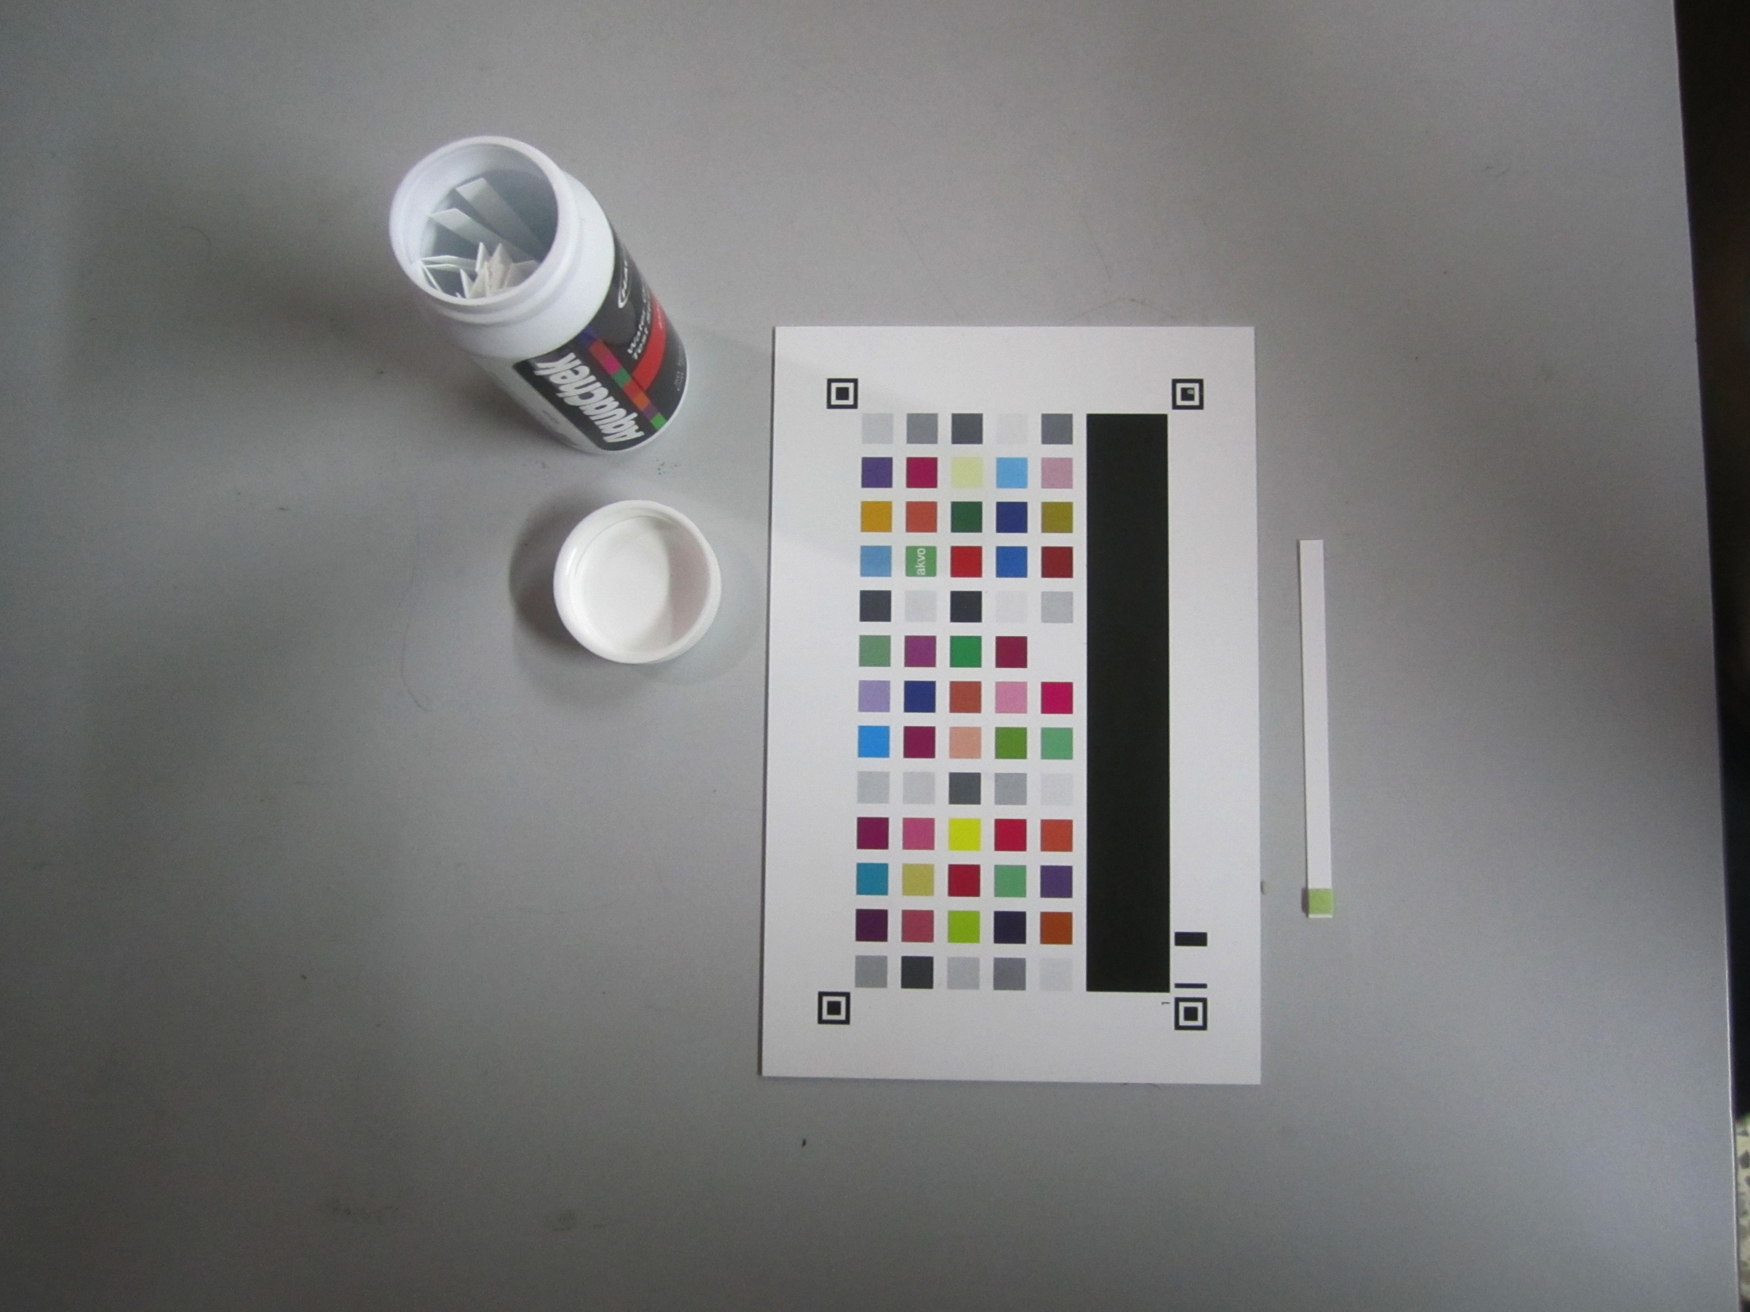
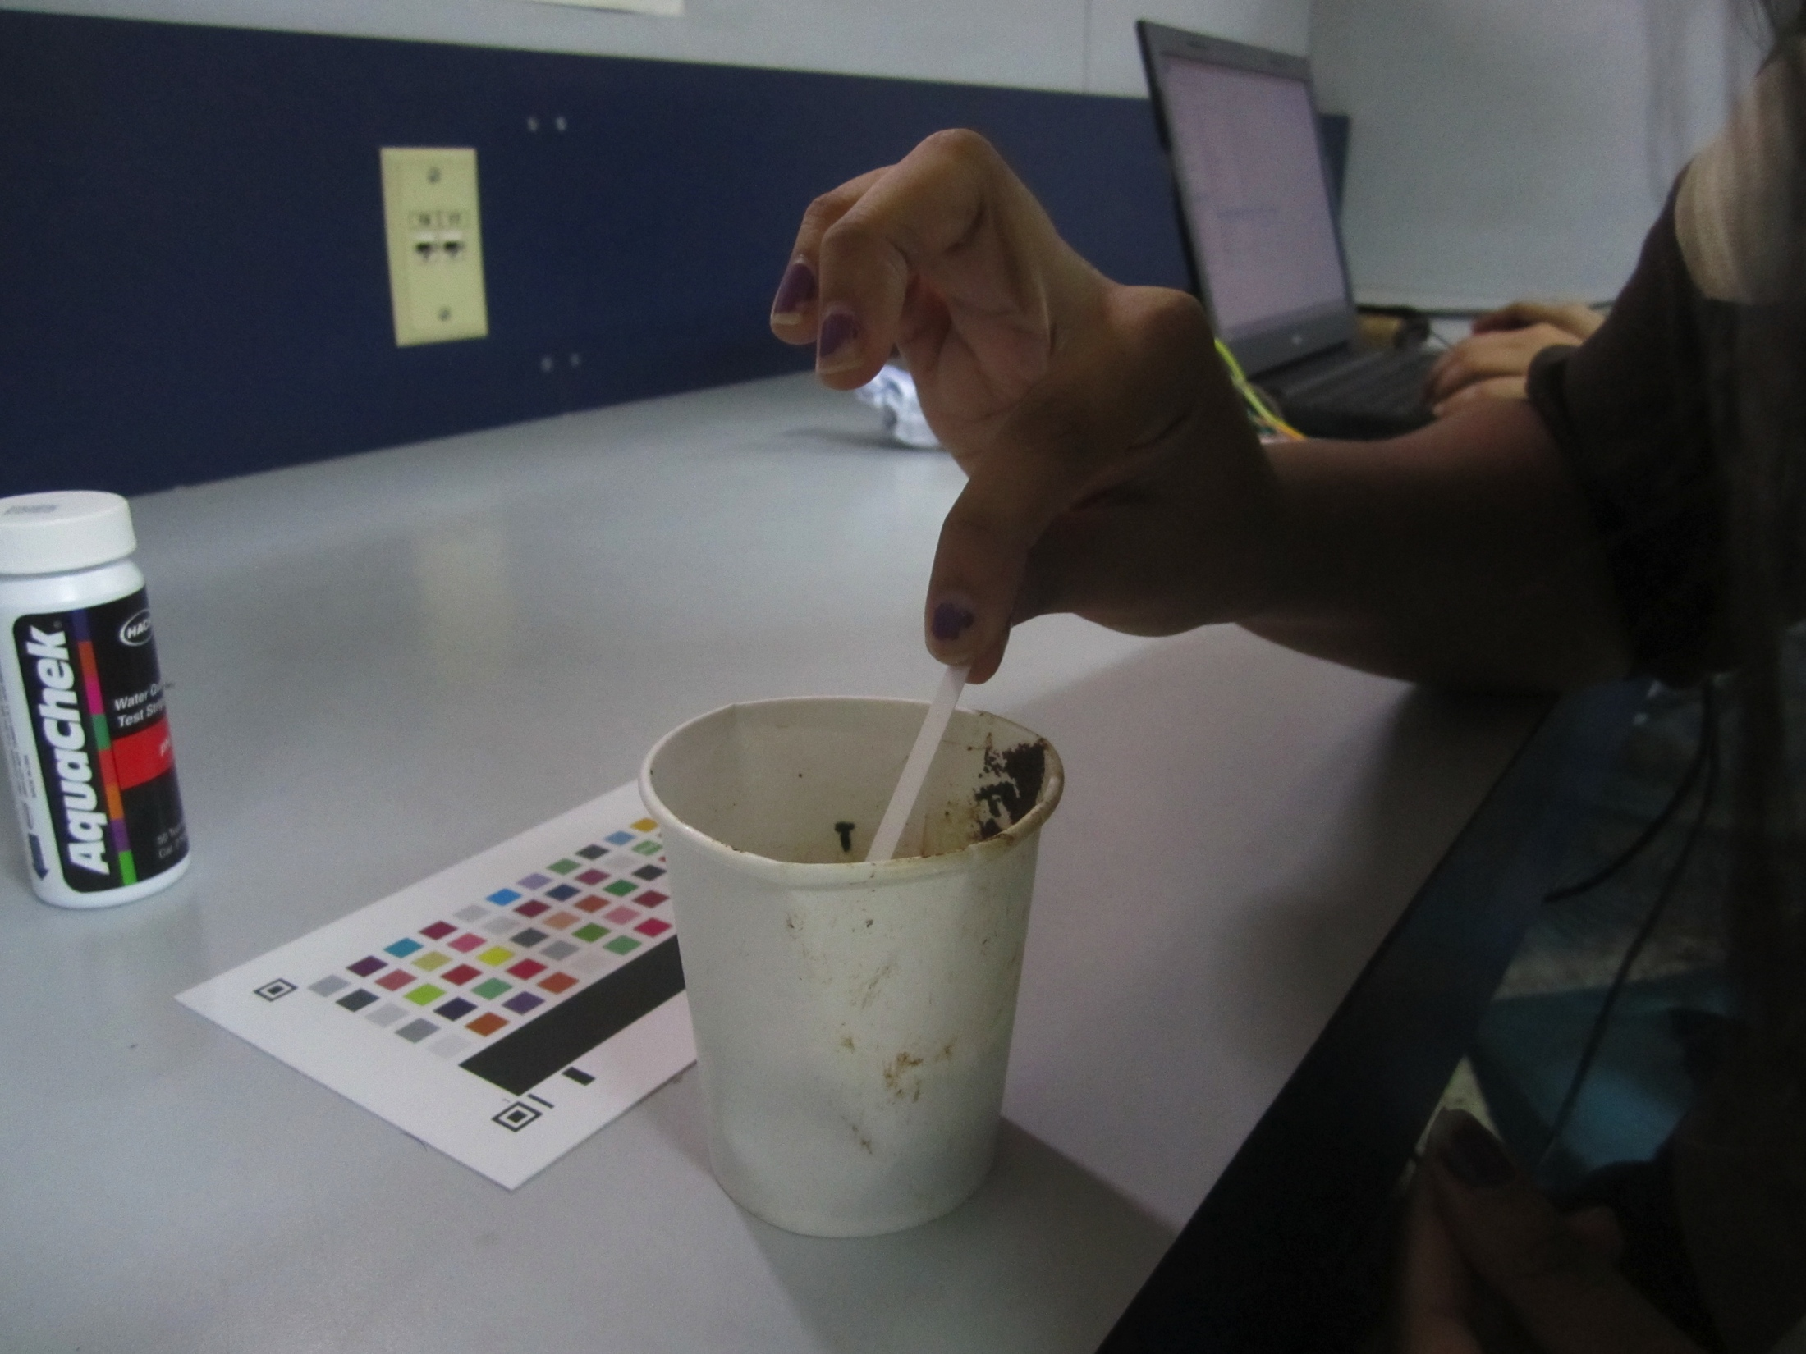
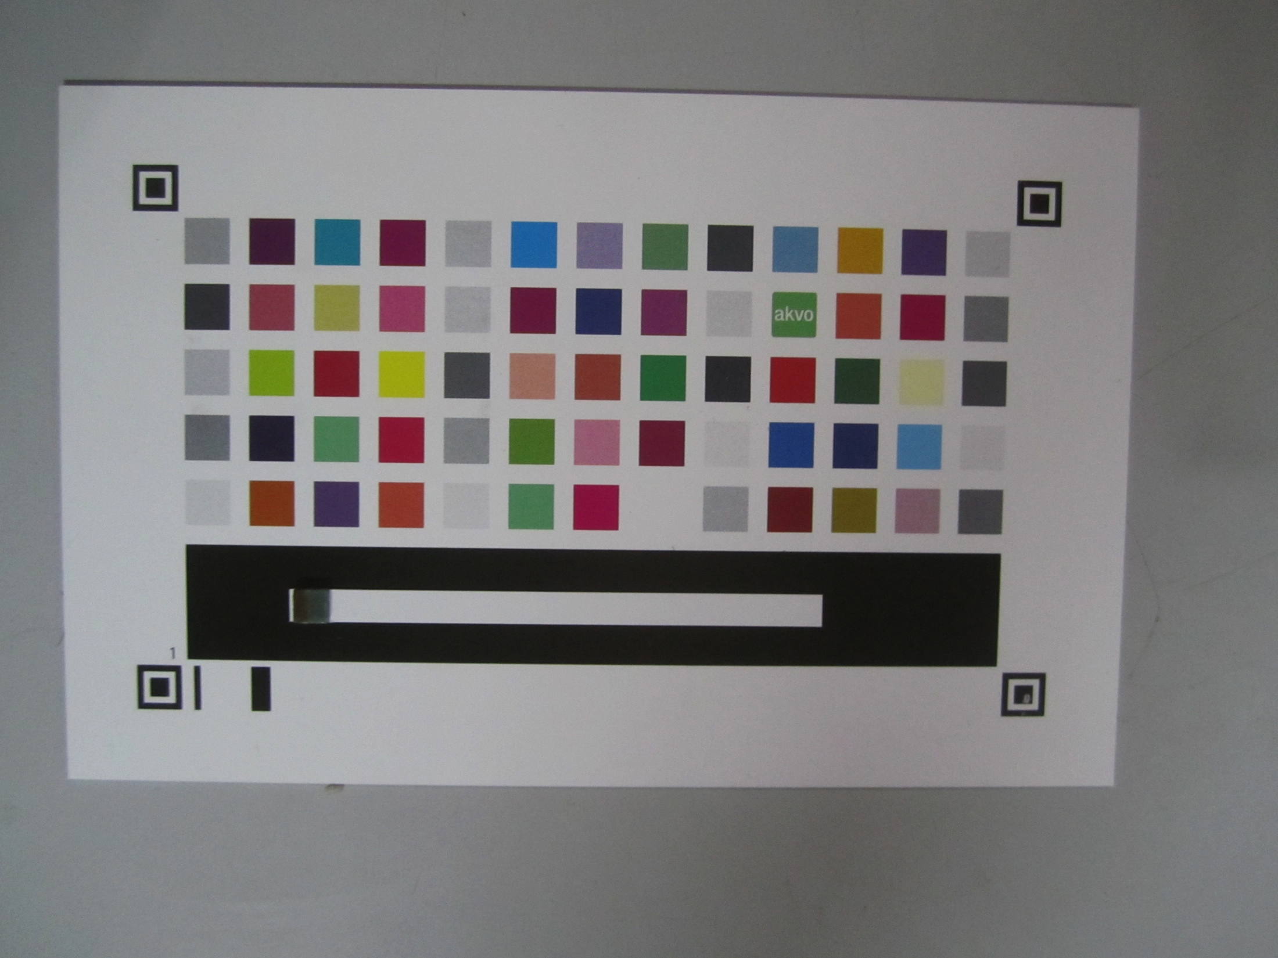
WATER QUALITY TESTING

Slide 6
UTILIZATION OF HARVESTED WATER
Based on the quality, the water can be routed to different tanks.
The water from the tanks can further be used for various purposes like watering plants, distributing water to the washrooms of the campus and in some cases cooking and drinking.

Slide 7
THANK YOU!

